Slide 1


Gujarat University﻿
School of Emerging Science and Technology ﻿
A Project for Real-Time Lane and Object Detection Using Deep Learning
Name: Daivik Raval
Sem – 7 (AIML-28)
Enrollment No.: 202222700038
Name: Abhijeet Routh
Sem – 7 (AIML-29)
Enrollment No.: 202222700023
Mentors :- Dr Hardik Soni

Slide 2
Abstract
This project aims to build a smart system that helps vehicles understand their surroundings using dashcam videos.
It uses deep learning to detect road lanes and nearby objects like cars, trucks, and pedestrians.
The system processes video frames in real time, identifies lane boundaries, and highlights moving objects to improve driving safety.

Slide 3
Abstract
By combining lane detection and object recognition, the system can assist drivers or support autonomous vehicles in making better decisions on the road.
The goal is to create a reliable and efficient perception system that mimics how humans see and react while driving.

Slide 4
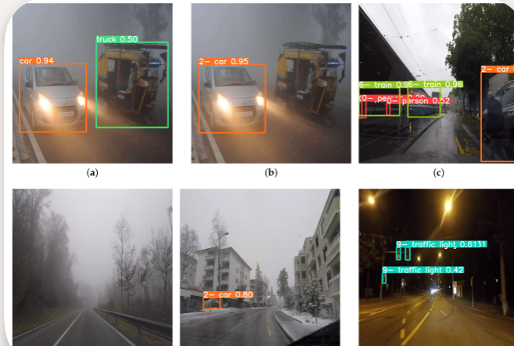
Introduction
This project is about helping vehicles "see" the road using AI.
We use dashcam videos to detect lane lines and nearby vehicles.
The system uses deep learning to understand what’s happening around the car.

Slide 5
Introduction
It shows lane boundaries and objects like cars, trucks, and people in real time.
This can make driving safer and is a step toward self-driving technology

Slide 6
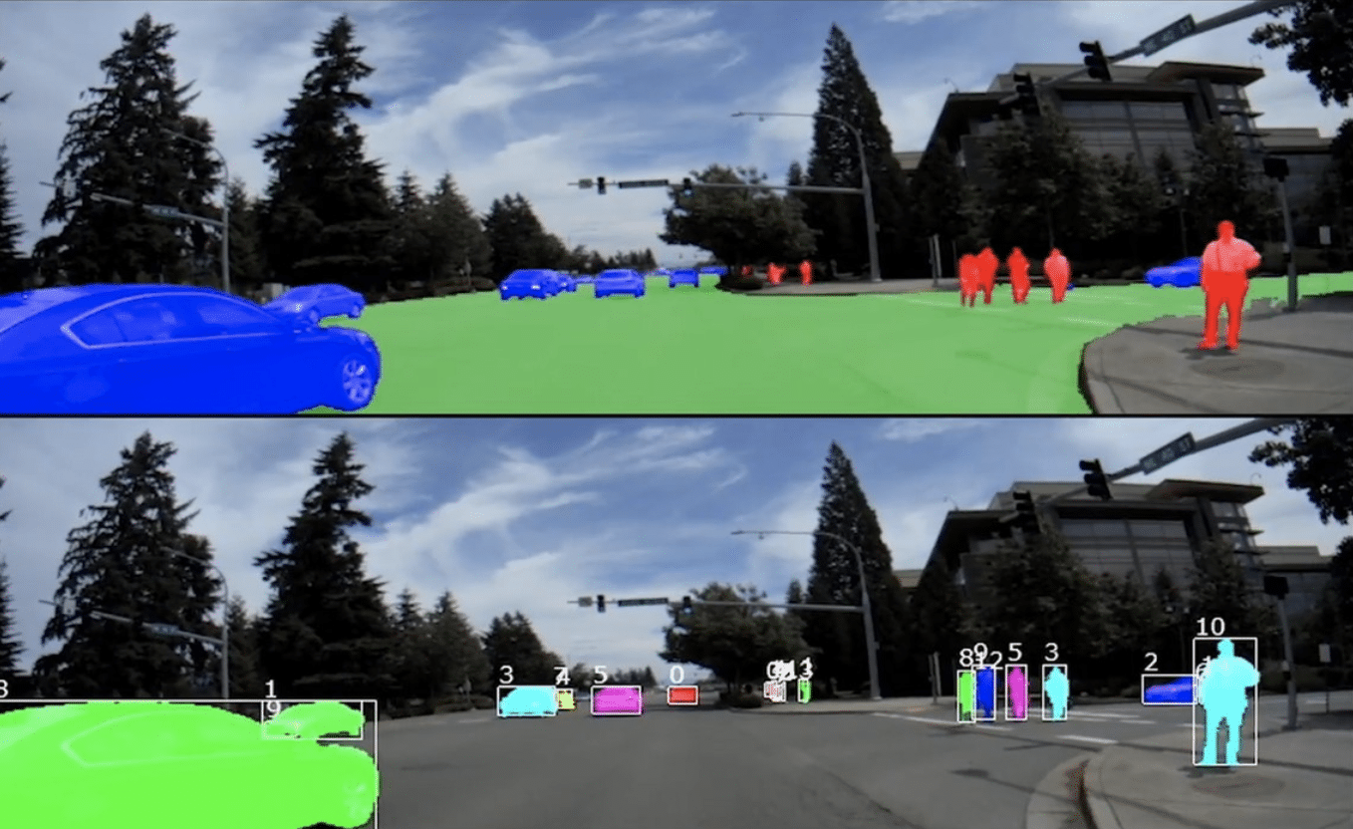
Objective
To build a smart system that helps vehicles understand the road using dashcam videos
Detect lane boundaries to keep the vehicle safely in its lane

Slide 7
Objective
Identify surrounding vehicles and objects like cars, trucks, and pedestrians
Improve driving safety and support the development of autonomous vehicles

Slide 8
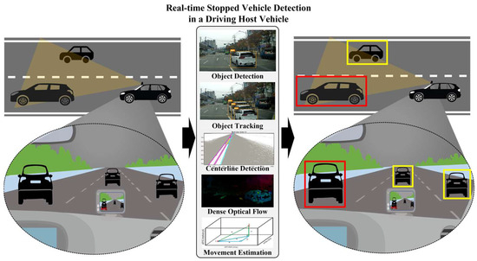
Constraints
Dashcam videos might be blurry or low quality, making it harder to detect lanes and vehicles.
Rain, fog, or darkness can make it hard to see lane lines or objects clearly.

Slide 9
Review of literature
Lane Detection Studies: We have used deep learning models to detect lane lines on different types of roads. These models work well even when the lanes are curved or faded.
Object Detection Research: Many studies use models like YOLO and SSD to find cars, trucks, and people in road videos. These models are fast and accurate, making them useful for real-time driving.

Slide 10
Review of literature
Autonomous Driving Systems: Past research shows that combining lane and object detection helps vehicles make better decisions. It improves safety and supports self-driving technology.

Slide 11
Methodology for Lane detection
Overview of the Code: The code builds a lane and object detection system using dashcam video frames and it uses OpenCV for lane detection and YOLOv8n for object detection.
Lane Detection Pipeline: Converts the frame to grayscale and applies Canny edge detection to find lane edges.
Fits polynomial curves to detected lane points for smoother lane visualization.

Slide 12

Methodology for Lane detection
Lane Smoothing : - The StableLaneSmoother class uses Exponential Moving Average (EMA) to smooth lane curves across frames.
Object detection with YOLOv8n : Loads a pretrained YOLOv8n model (yolov8n.pt) to detect objects like cars.
Distance Estimation : Estimates how far a car is using the formula.

Slide 13
Methodology for Object detection
1. Import Libraries :
Loads the YOLOv8n model from deep learning model.
Uses OpenCV to draw boxes and labels on the image.
2. Load the YOLOv8n Model :
Loads the YOLOv8n model (a lightweight version)
Pretrained to detect common objects like cars, people, bikes, etc.

Slide 14
Methodology for Object detection
3. Define the Detection Function :
Takes a video frame as input.
Runs YOLOv8n to detect objects.
4. Loop Through Detected Objects :
Extracts box coordinates.
Gets the confidence score and class label (e.g., "car", "person").

Slide 15
Methodology for Object detection
5. Draw Boxes and Labels :
Draws a blue rectangle around the object.
Adds a label with the object name and confidence score.
6. Return the Annotated Frame
Returns the frame with all boxes and labels drawn.
Ready to display or save as part of your video output.

Slide 16
Methodolody
1. Import Functions :
Loads your custom lane and object detection functions.
Uses OpenCV for video capture and display.
2. Start Webcam :
Opens the default webcam (camera index 0).
Checks if the camera is working.

Slide 17
Methodology
3. Set Up Video Writer :
Prepares to save the processed video to a file.
Sets resolution and frame rate.
4. Main Loop: Frame-by-Frame Processing
Captures each frame from the webcam.
If capture fails, the loop exits.

Slide 18
Methodology
5. Run Lane and Object Detection :
First detects lane lines.
Then detects objects like cars and adds bounding boxes.
6. Save and Display Output :
Saves the processed frame to a video file.
Displays the result in a live window.

Slide 19
CONCLUSION
This project successfully combines lane detection and object detection using deep learning and dashcam video.
It shows how AI can help vehicles understand the road and make safer decisions.
The system works in real time, detects vehicles, estimates distance, and highlights lane boundaries.

